Slide 1
D4/D6 – new generation
Features and benefits

Slide 2
Refined to perfection – designed for people
Trust
Cost
User experience
Increased reliability
Lower cost of ownership
Increased performance
Notes:
Customer surveys
Customer clinics at Krossholmen
Experience of 100000 engines in use
Answer has been clear:
A product that you can rely on and trust
Lower costs for service and less time spent on maintaining the equipment
More power, comfort and a better user experience
These needs we have translated into product development requirements

Slide 3
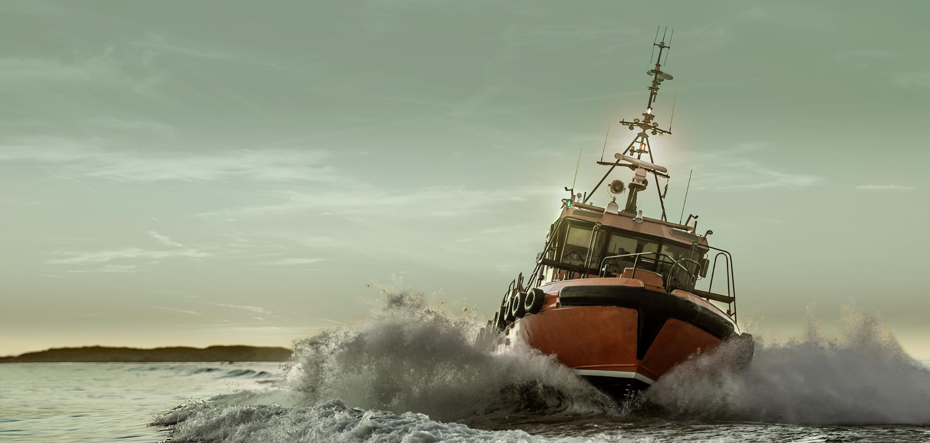
Increased reliability
24h
85%
Unpredictable service disruptions
Wider range for commercial use
Increased reliability
Lower cost of ownership
Increased performance
Notes:
Trust in our propulsion systems, that is the most important demand from our customers, this applies to commercial as well as leisure customers. That is why we set targets in the project to increase reliability.
This is not a small face lift, the engines are completely reengineered, refined for perfection, actually 85% of the content is updated, redesigned, improved
Increased reliability. Means we can expect less disruptions for unpredictable problems.
And as a proof of the higher reliability we can now offer more engine specs than what we could offer before for rating 4 operations.

Slide 4
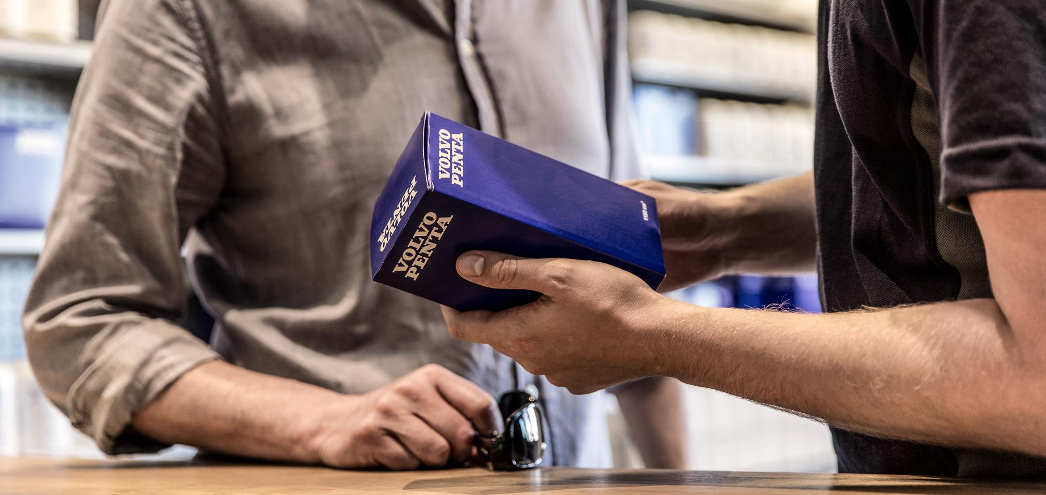
Lower cost of ownership
+
+
-
-
Up to 7%
Up to 20%
Increased reliability
Up to 40%
Lower cost of ownership
Increased performance
Notes:
The second customer demand was about cost, and we have reduced the fuel consumption up to 7% across the range, maintenance labor is up to 20% less and parts and lubricants are up to 40% less.
This is done by:
Longer service intervals
Synchronized service
Less service points
Easier service operations

Slide 5
Increased performance
Power
Comfort
Easy Boating
Increased reliability
Lower cost of ownership
Increased performance
Notes:
The third area that is important for our customers is the user experience. This is translated into performane requirements in three areas: Power, comfort and easy boating
When it comes to power we have
10% power increase across the range
We can then power larger boats with the new D4/D6 or get more power on current boat models
Regarding comfort the biggest news is the
Completely new DPI with silent shift and low speed mode
Smoother and more precise running engine
Last but not least when it comes to easy boating the new D4/D6 offers
Improved maneuverability, especially fantastic improvement on the sterndrive with new features
Better diagnosibility and system monitoring of the complete package
And easier service on the IPS

Slide 6
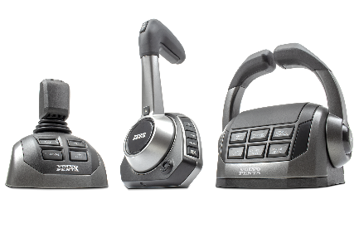
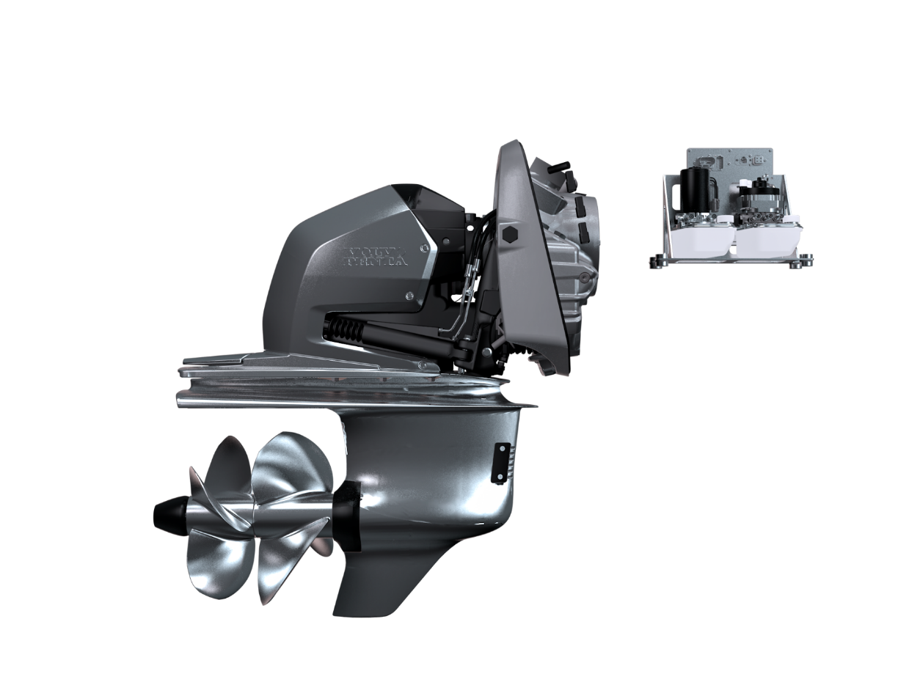
New generation D4/D6 – the package
Re-engineered D4/D6 engine
Enhanced EVC system
A completely new sterndrive
An upgraded IPS

Slide 7
New generation D4/D6
Re-Engineered D4/D6 engine
Enhanced EVC system
Extended power range, 150-480hp
Improved reliability
Less service items
Longer between services
Expanded offer
Complete vessel approach
New colors on controls
Quicker SW download
Prepared for future
A completely new sterndrive
An upgraded IPS
Unmatched comfort
Increased functionality
More power – D4320 / D6440
Higher durability
Lower ownership costs
Improved serviceability
Lower cost of ownership
Improved reliability and durability
New top spec D6-IPS650

Slide 8
Re-Engineered D4/D6 engine
Designed for sea
Torque for marine use
Truly marine
Engine and transmission in perfect match
Reliability / durability
Enforced components
Better diagnosability
Cost of ownership
Less service items and longer intervals
Lower fuel consumption
Performance
Extended power range, 150-480hp
Smoother running

Slide 9
The new sterndrive – DPI
Easy boating and comfort
Steer by wire
Hydraulic clutch
Performance
New top spec – D4-320 and D6-440
New propeller series
Reliability / durability
Enforced components
New propeller seals
Cost of ownership
Less service items and longer intervals

Slide 10
An upgraded IPS
Cost of ownership
Less service items and longer intervals
Oil exchange from inside boat
Reliability / durability
Enforced design
New oil filtration system
New propeller shaft seals
Performance
New top spec D6-IPS650

Slide 11
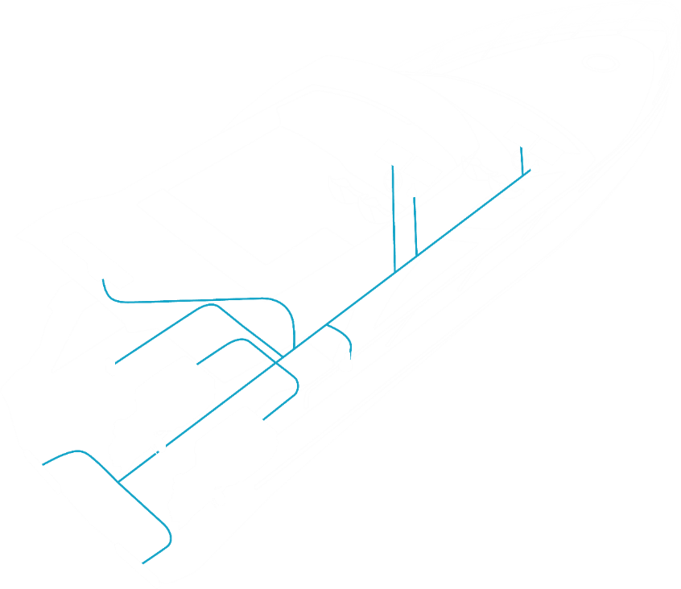
Enhanced Electronic Vessel Control system
Expanded offer
Single Steer by wire
Maintenance Assistant
Complete vessel approach
From prop to antenna
From order to ownership
New electrical architecture
Software Download time is reduced by 50%
Prepared for connectivity, automation and electromobility
New colors on controls

Slide 12
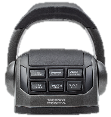
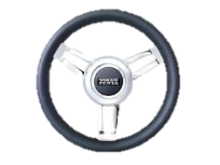
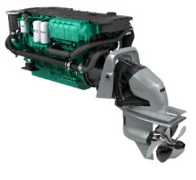
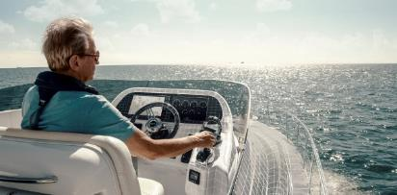
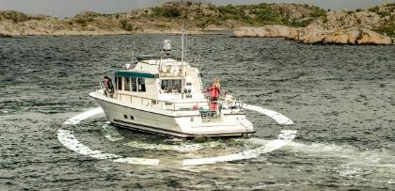
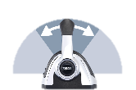
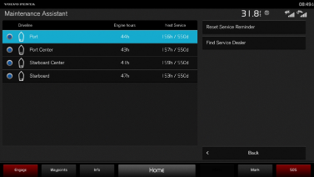
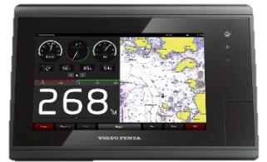
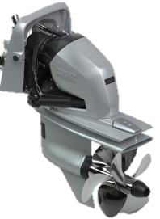
Expanded offer
Single Steer-by-Wire and silent shift
Joystick Driving with auto pilot on single DPI
Dynamic Position System for twin DPI
Maintenance assistant with service alert
Auto pilot for single DPI
Low speed is standard on IPS and DPI

Slide 13
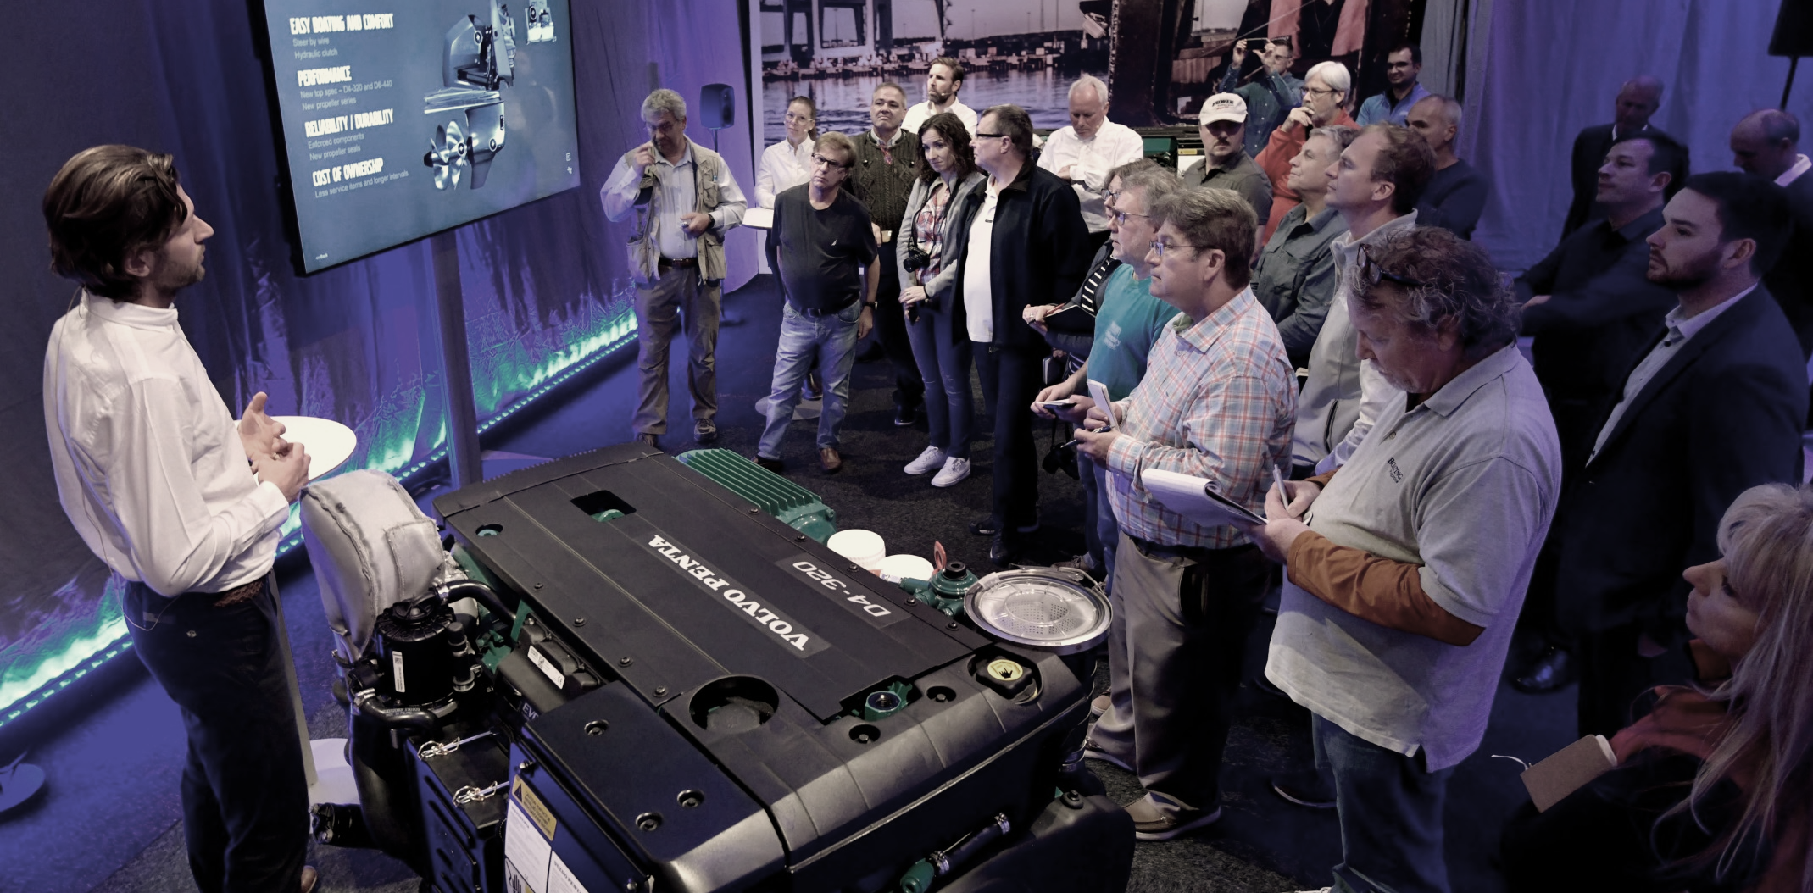
Publicity and awards
Awards
Innovation award for its DPI driveline at the Dusseldorf International Boat Show
IBEX Innovation Award for its Next-Generation D4 and D6 Marine Propulsion Systems
Boating Industry Recognizes Volvo Penta D4 and D6 Marine Propulsion Systems in Top Boating Products of the Year

Slide 14
Thank you!
Notes:
That was a quick summary of the first year with the new D4/D6.
Petter and I would like to thank you for your attention and wish you a good day.

